Slide 1
Course Wrap-up & TA-led Activities
CSE 390B Reflection and Victory Lap, CSE 390B Course Staff Panel, Jeopardy Game

Slide 2
Lecture Outline
CSE 390B Reflection and Victory Lap
Metacognitive Skills
Nand2Tetris Projects
CSE 390B Course Staff Panel
Ask About Class Recommendations, Extracurriculars, etc.
Jeopardy Game
Topics: UW History, CSE 390B Course Staff, Seattle, Pop Culture

Slide 3
Remember this?
The UW Student Experience
Math
Metacognitive
Skills
CSE
Nand2Tetris
Projects
Sociology
CSE 390B

Slide 4
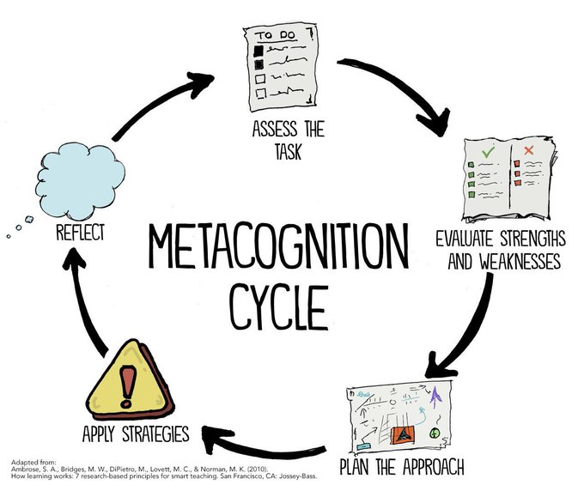
Metacognitive Skills Victory Lap!
Time Management
Note-Taking
Annotation
Exam Preparation
Test-Taking
Post-exam Reflection
Debugging
Working with Instructors & TAs
Reflection on Metacognition

Slide 5
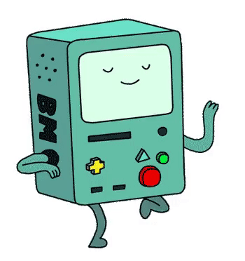
Nand2Tetris Projects
By building a computer, you’ve accomplished something that very few others have done!
Many software writers consider building the computer as Somebody Else’s Problem™
But so many technical skills and CSE courses tie into this task
And even if you only write Java for the rest of time…
Understanding the “layer below” makes you a better engineer in the “layer above”!

Slide 6
Boolean function synthesis
Practice with HDL—an unfamiliar, declarative style of programming
Project 2
Basic Logic Gates
NAND

Slide 7
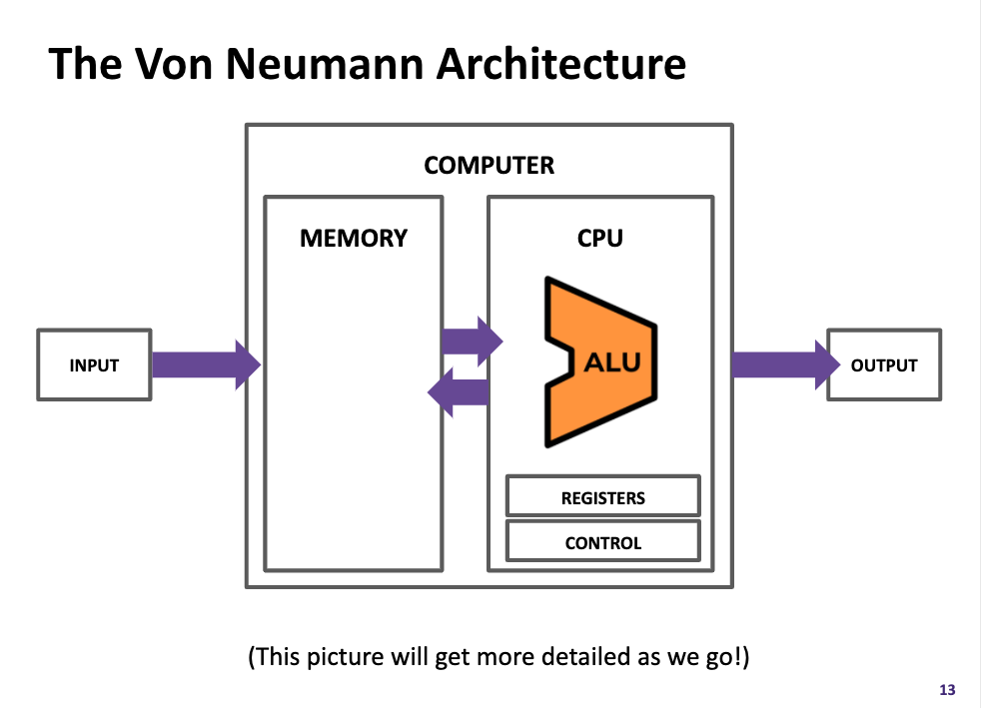
Components found in “real-world” computers: ALU, PC, Memory...
Learning a mental model for sequential logic
Project 4
Memory
Project 3
ALU
PC
Basic Logic Gates
NAND

Slide 8
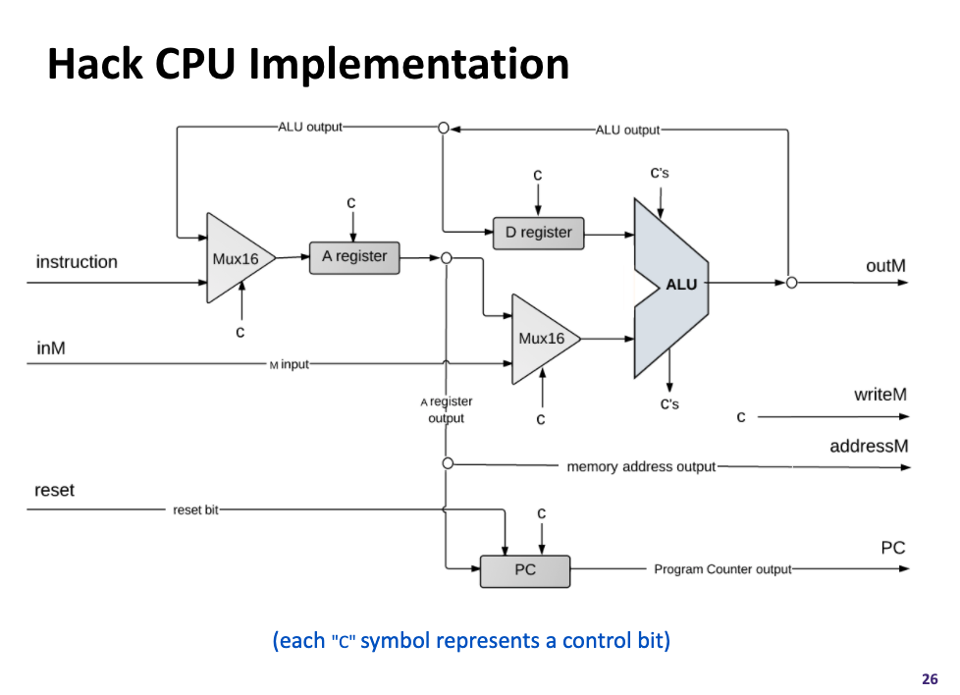
Project 5
Assembly Language
Assembler
Machine Code
Project 6
Computer
Memory
CPU
The connection between software and hardware through binary instructions
What must happen in a clock cycle to process one instruction
ALU
PC
Basic Logic Gates
NAND

Slide 9
High-Level Language
Project 8
Intermediate Language(s)
Assembly Language
Operating System
Assembler
Machine Code
Computer
Memory
CPU
What happens when you click that green run button?
Programs can read in programs and then spit out equivalent programs
ALU
PC
Basic Logic Gates
NAND

Slide 10
Roadmap
SOFTWARE
HARDWARE
High-Level Language
Intermediate Language(s)
Assembly Language
Operating System
Assembler
Machine Code
Computer
Memory
CPU
ALU
PC
Basic Logic Gates
NAND

Slide 11
SOFTWARE
HARDWARE
331: Software Design 332: Data Structures 421: Algorithms
446: ML … & many more
341: Programming Languages
High-Level Language
Intermediate Language(s)
401: Compilers
333: Systems Programming
Assembly Language
Operating System
451: Operating Systems
452: Distributed Systems
461: Networks
Assembler
351: HW/SW Interface
Machine Code
Computer
Memory
CPU
469: Computer Architecture
ALU
PC
311: Foundations I
Basic Logic Gates
369: Digital Design
NAND
371: Digital Circuits

Slide 12
Takeaways: Why Build a Computer?
A significant engineering effort
You practiced so many skills and programmed with so many different languages, tools, & paradigms—and you can do it again!
We hope this was a demystifying experience
To not see CSE courses as isolated but as interconnected puzzle pieces
We hope you had fun in this learning journey!
The computing field is broad and has much for you to explore
We are hopeful you found a topic you want to pursue further, both technically and metacognitively

Slide 13
Lecture Outline
CSE 390B Reflection and Victory Lap
Metacognitive Skills
Nand2Tetris Projects
CSE 390B Course Staff Panel
Ask About Class Recommendations, Extracurriculars, etc.
Jeopardy Game
Topics: UW History, CSE 390B Course Staff, Seattle, Pop Culture

Slide 14
CSE 390B Course Staff Panel
Ask us about:
Classes
Recommendations for easy, hard, useful, etc. classes
What classes go well with each other
Extracurricular activities
TAing
Research
Allen School RSOs
UW RSOs
Internships

Slide 15
Lecture Outline
CSE 390B Reflection and Victory Lap
Metacognitive Skills
Nand2Tetris Projects
CSE 390B Course Staff Panel
Ask About Class Recommendations, Extracurriculars, etc.
Jeopardy Game
Topics: UW History, CSE 390B Course Staff, Seattle, Pop Culture

Slide 16
Jeopardy Game
Organize into teams of 3-4 students
The first team to raise their hand and answer the question wins that round and chooses the next question

Slide 17
Post-Lecture 20 Reminders
Office hours and student-TA 1:1 meetings end this week
Course staff open to meeting during finals week by appointment
Project Reminders
Final Project, Part I: E-Portfolio Outline due tonight (12/8) at 11:59pm
Final Project, Part II: Final E-Portfolio due next Tuesday (12/13) at 4pm
If you have any uncompleted projects, the last day to turn them in is next Friday (12/16) at 11:59pm
Please fill out course evaluations if you haven’t already

